Slide 1
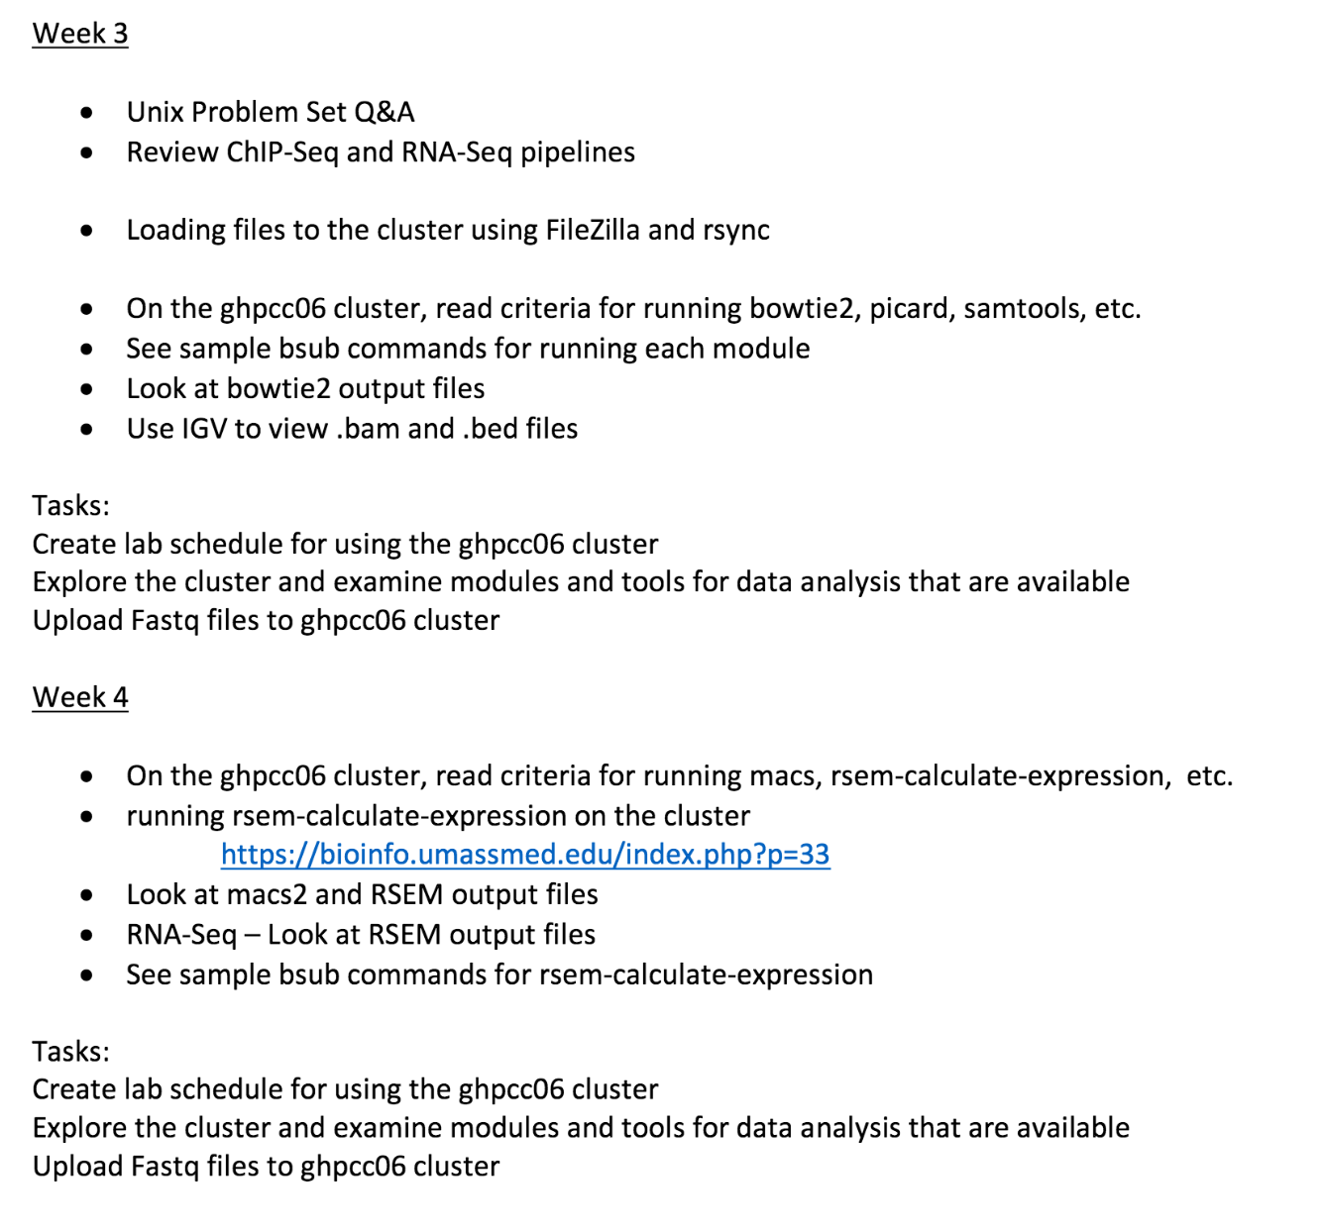

Slide 2
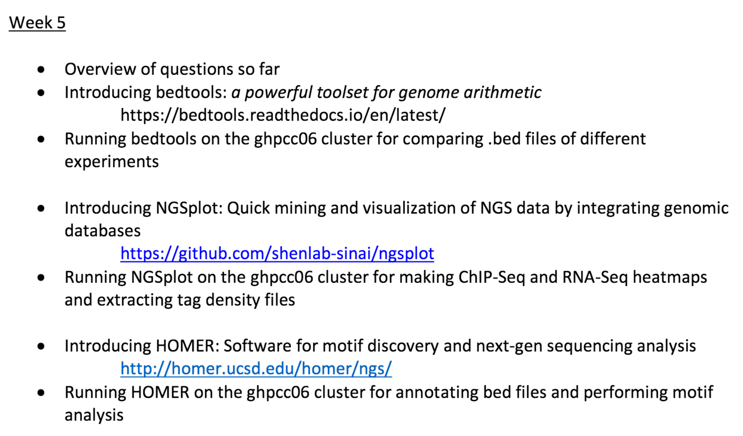

Slide 3
My ChIP-Sequencing Workflow
Raw Reads
fastq
.tdf to visualize
(IGV tools)
Map to genome (Bowtie2)
Bam Index (picard)
Sort Sam
(picard)
MAPQ filter (samtools)
Peak Analysis
(macs2)
Mark duplicates
(picard)
Merge runs
(picard)

Slide 4
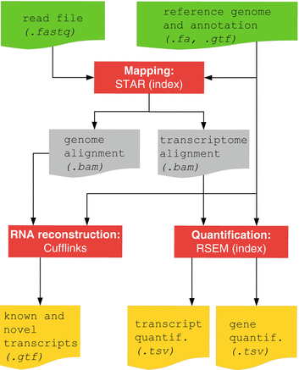
RNA-Seq Pipline
Methods and Tools
Bowtie and Bowtie2 use Burrows-Wheeler indexing for aligning reads. With bowtie2 there is no upper limit on the read length
Bowtie2
Bowtie2 to align reads in a splice-aware manner and aids the discovery of new splice junctions
RSEM is a software package for estimating gene and isoform expression levels from RNA-Seq data. The RSEM package provides an user-friendly interface, supports threads for parallel computation of the EM algorithm, single-end and paired-end read data, quality scores, variable-length reads and RSPD estimation.

Slide 5

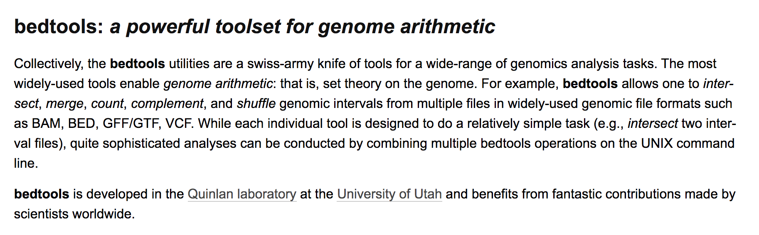
Bedtools
https://bedtools.readthedocs.io/en/latest/

Slide 6
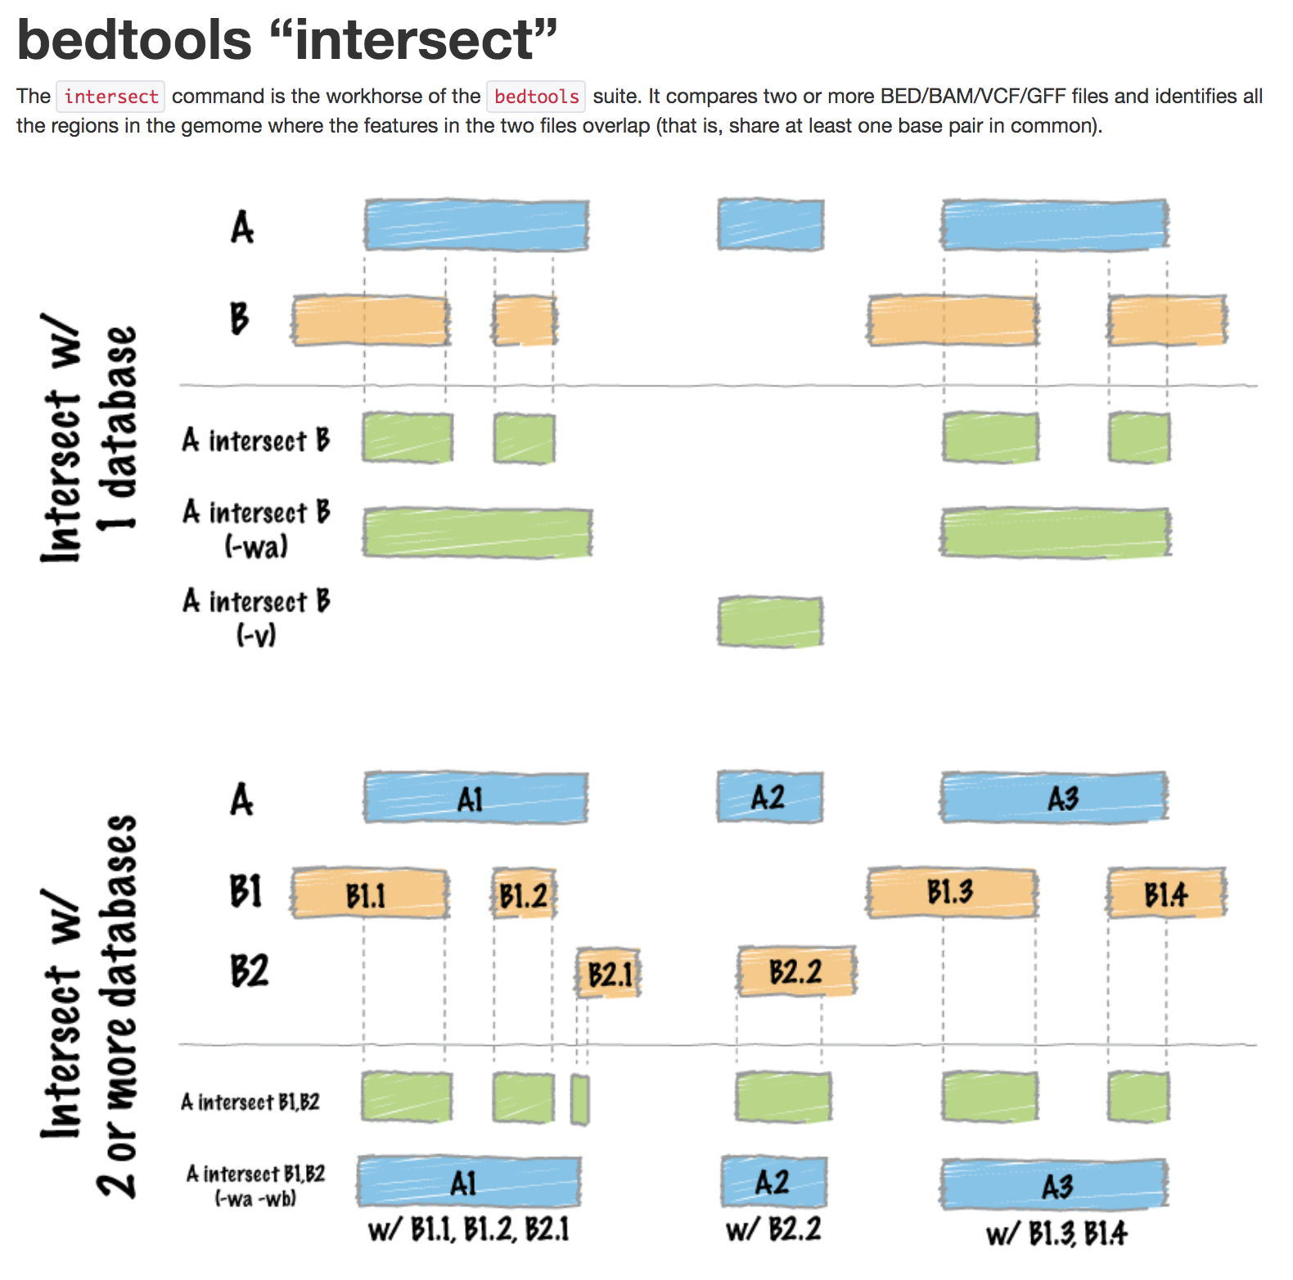

Slide 7
ChIP-Seq comparision
Brg1 Peaks
Mtf1 Peaks

Slide 8
ChIP-Seq and RNA-Seq comparison
Differentially Expressed
Gene coordinates
Mtf1 Peaks

Slide 9
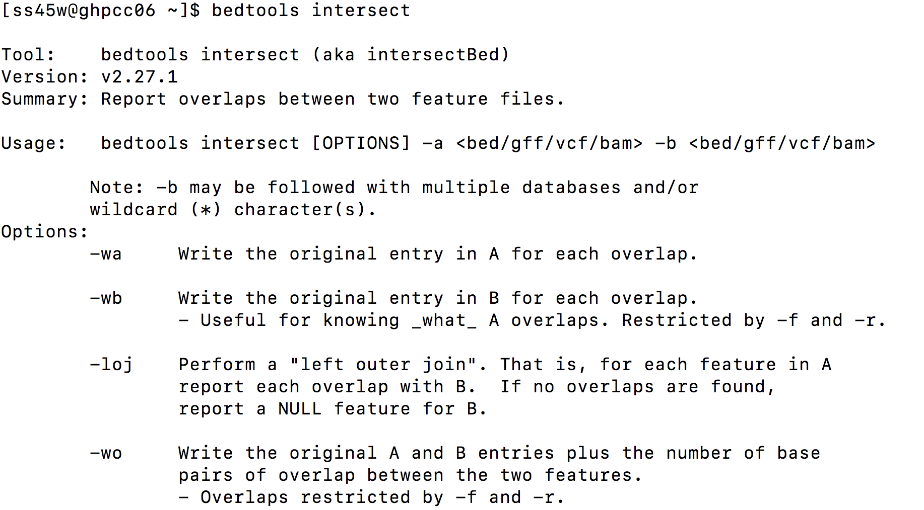

Slide 10
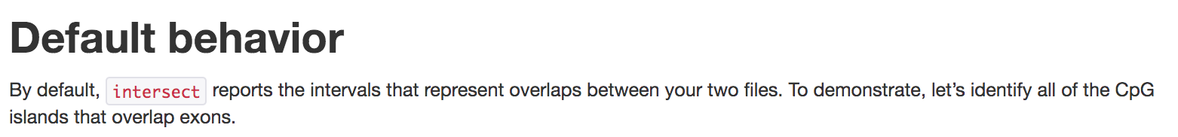
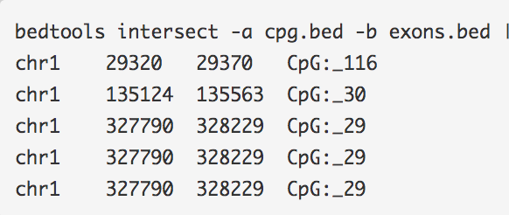
bedtools intersect -a D0Prmt5_n1n2_q0.05_PE_peaks.narrowPeak.bed -b D0_H3K27ac_q0.1_peaks.narrowPeak.bed > D0_3T3L1_PE0.05Prmt5_D0_H3K27ac_overlap.txt

Slide 11
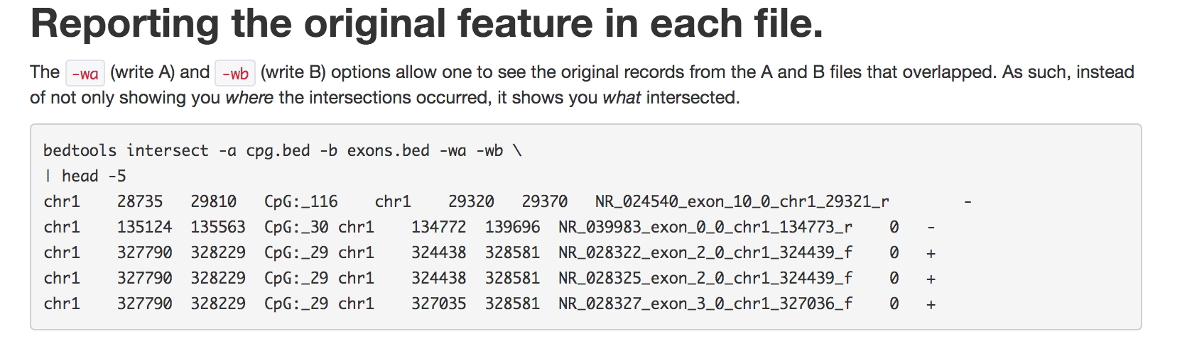

Slide 12
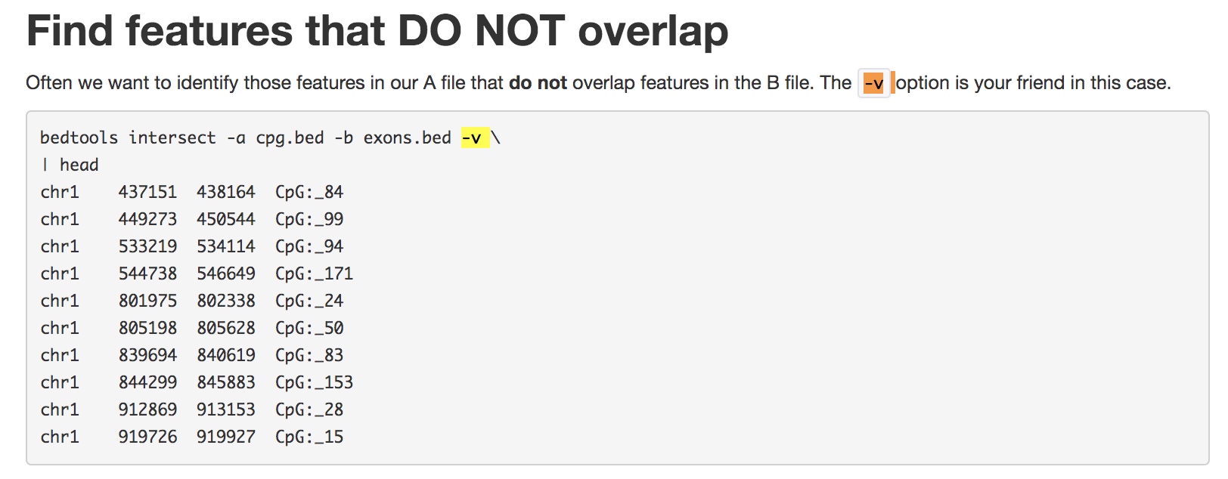

Slide 14
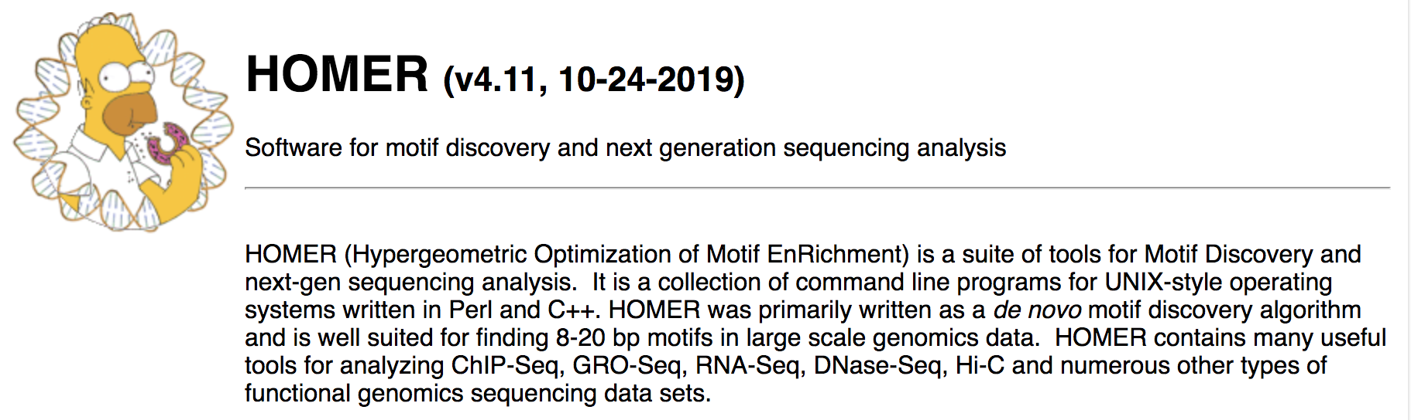
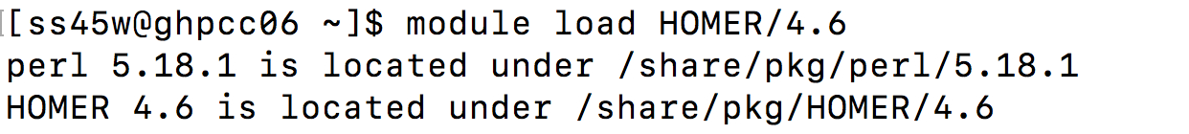

Slide 15
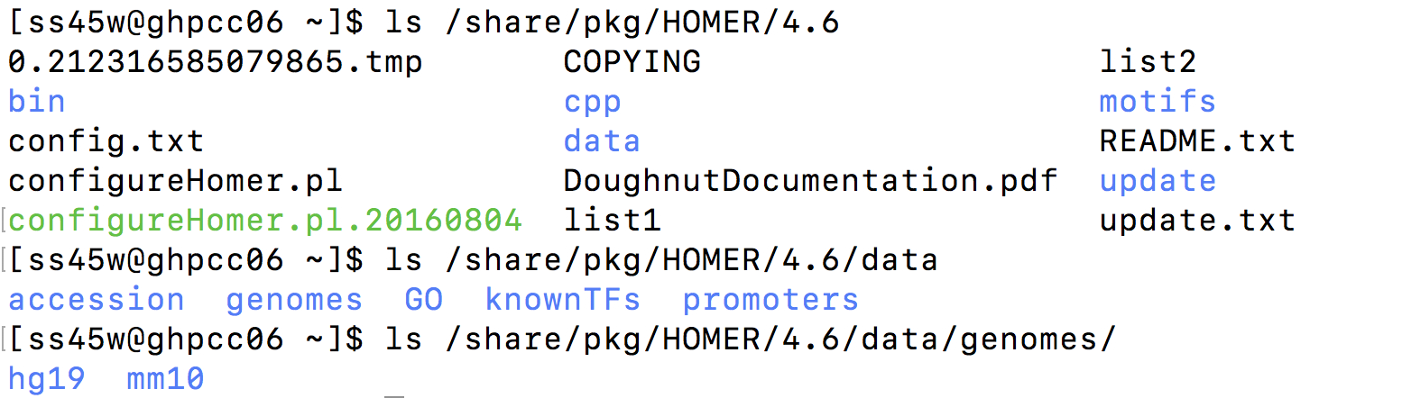

Slide 16
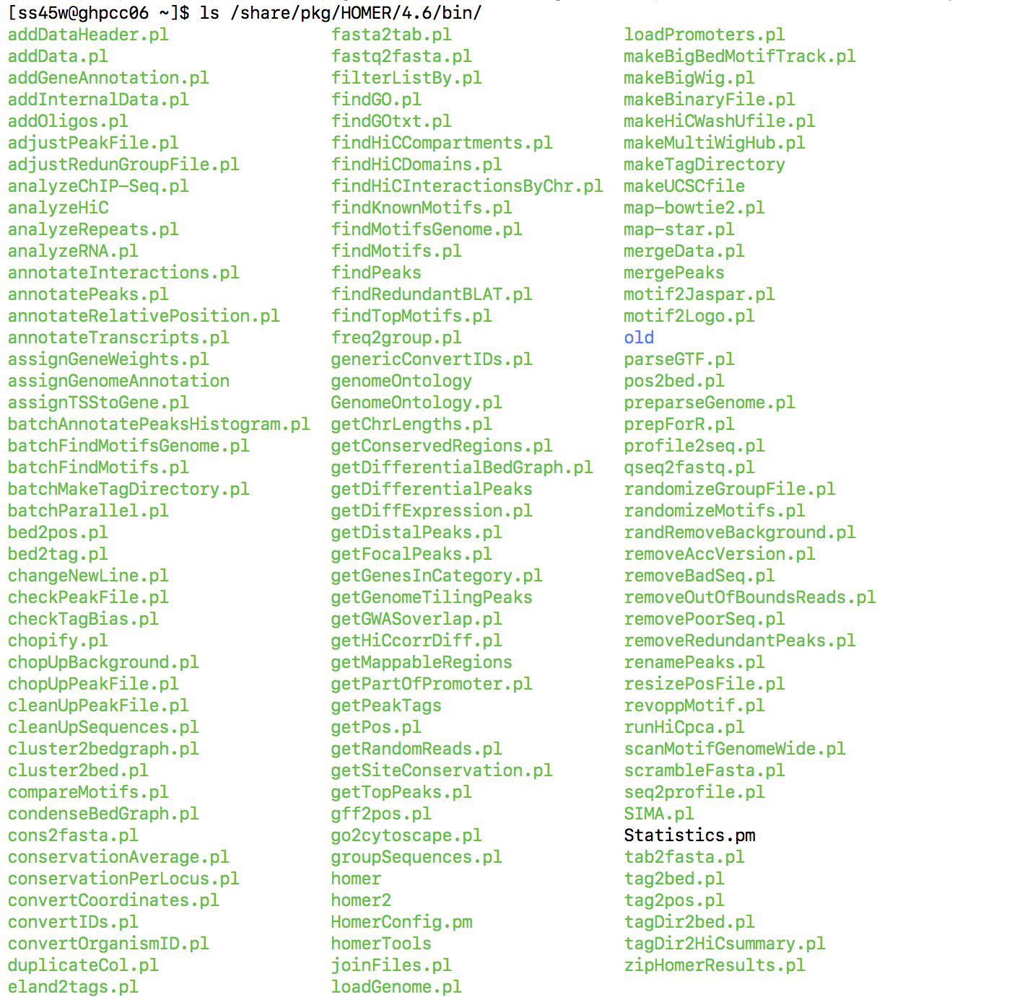

Slide 17
HOMER for annotating .bed files

Slide 18
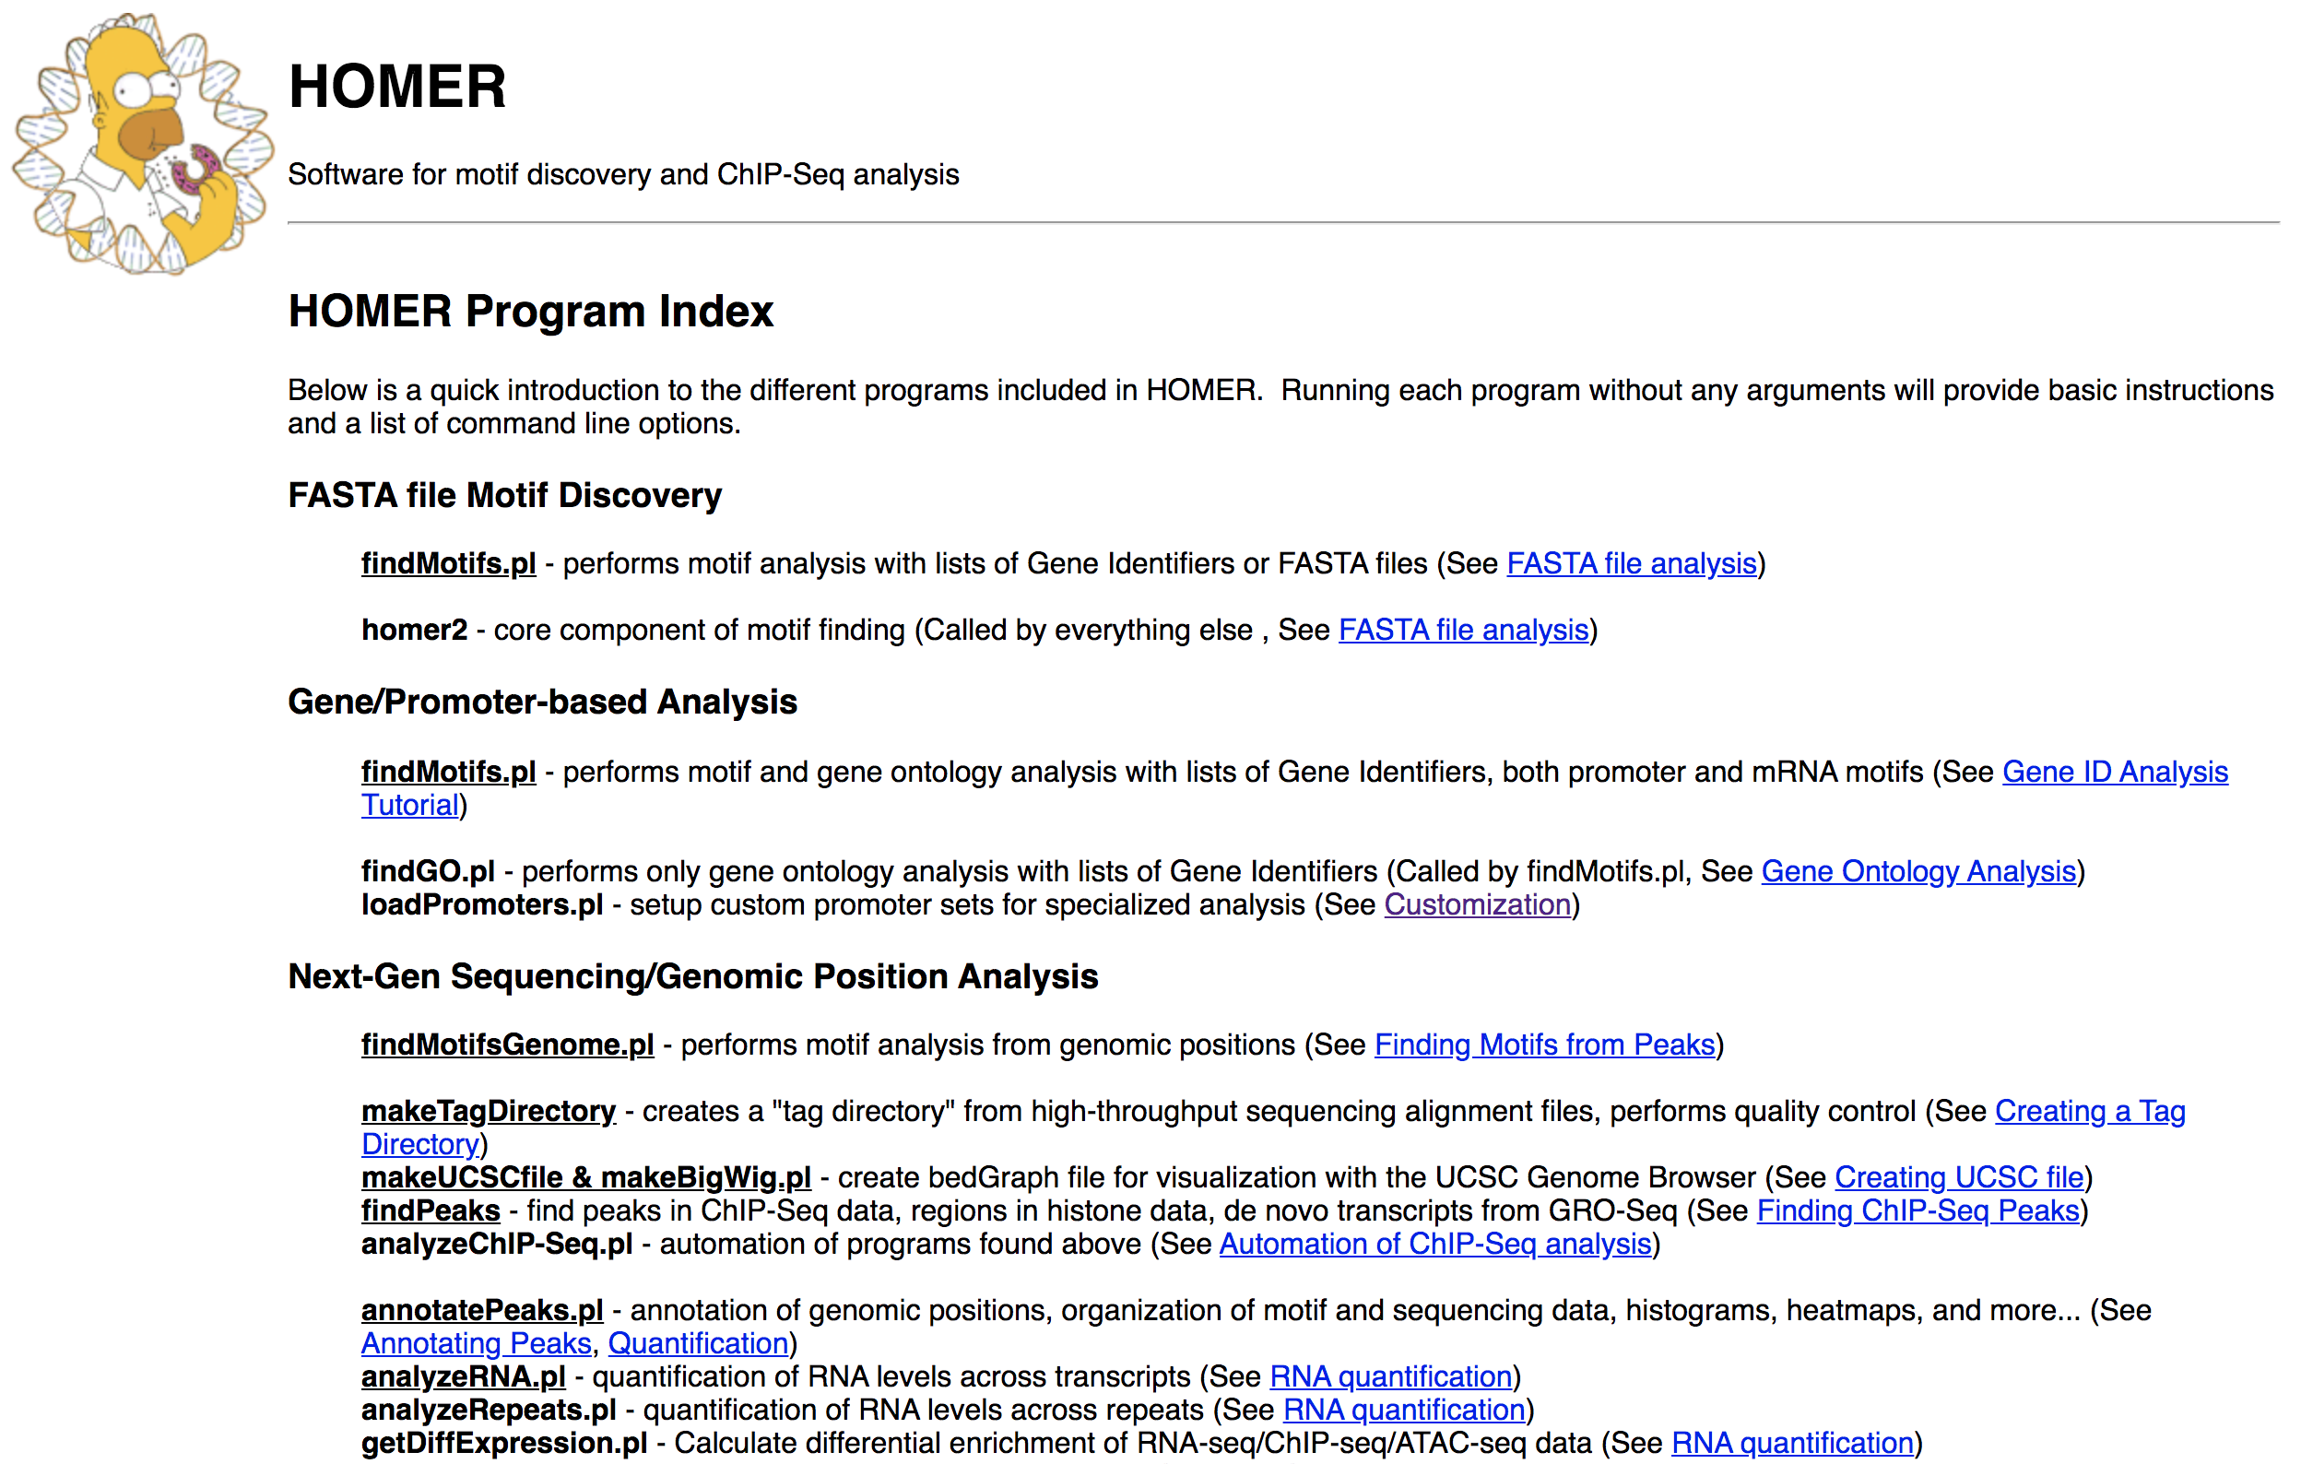
http://homer.ucsd.edu/homer/introduction/programs.html

Slide 19
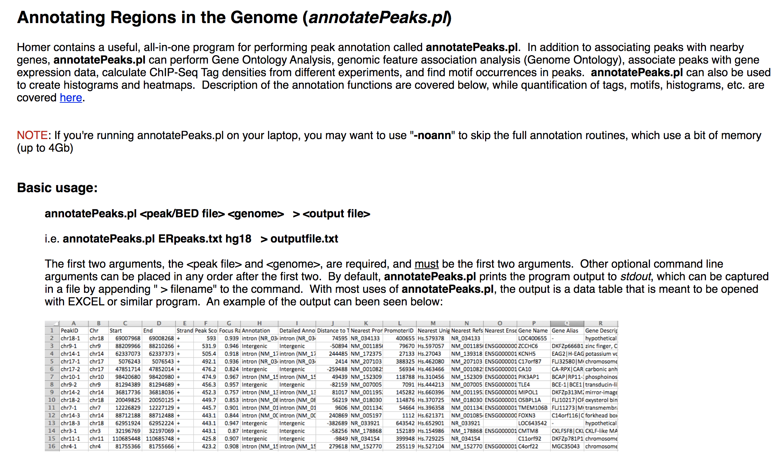

Slide 20
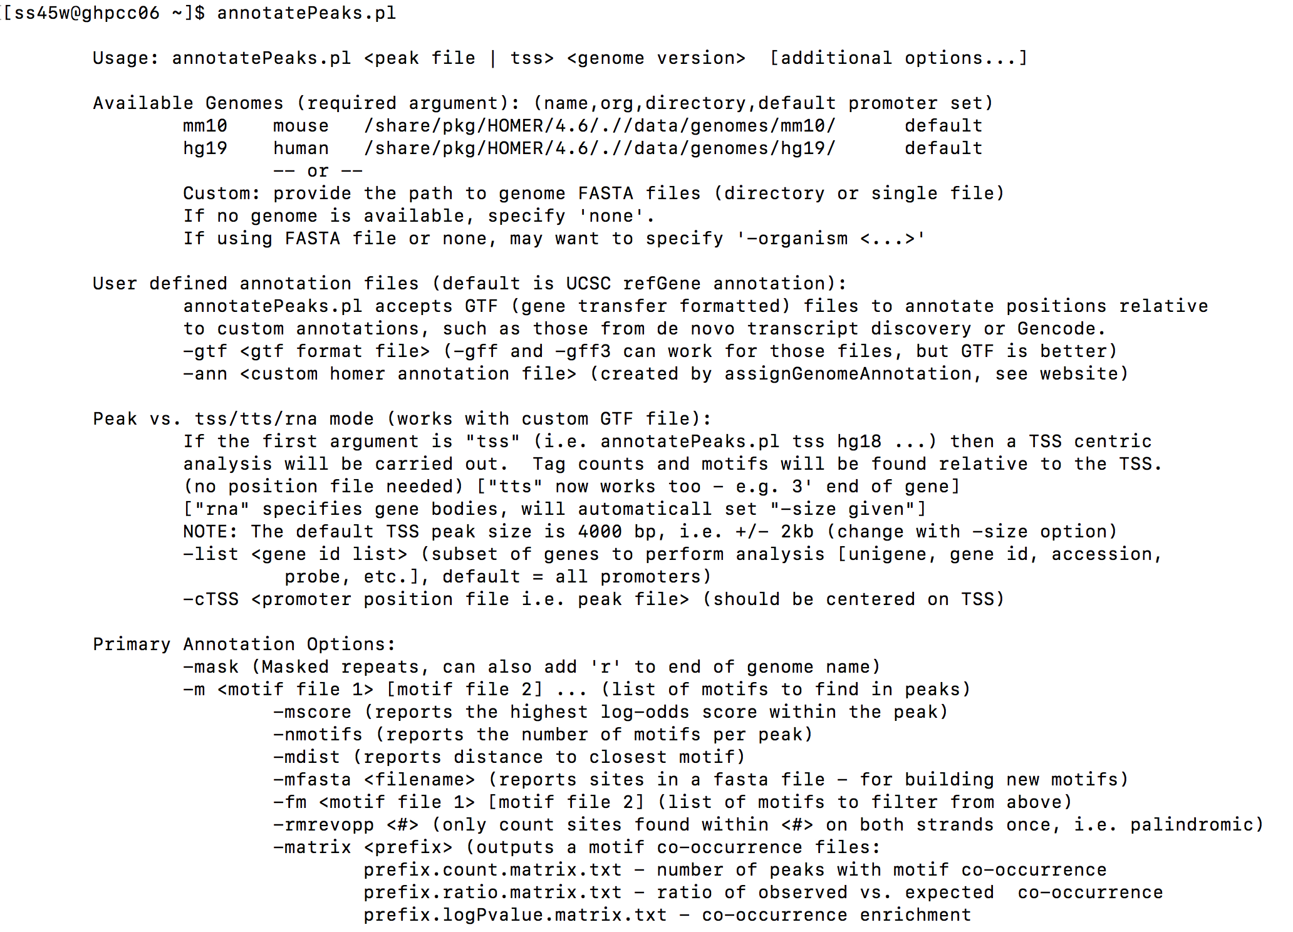
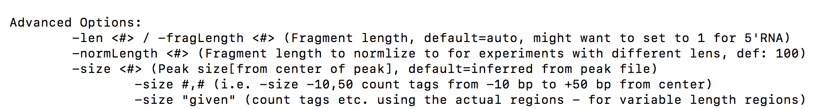

Slide 21
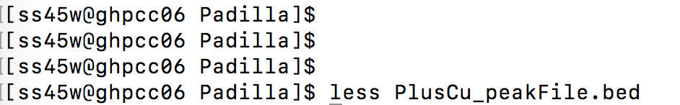
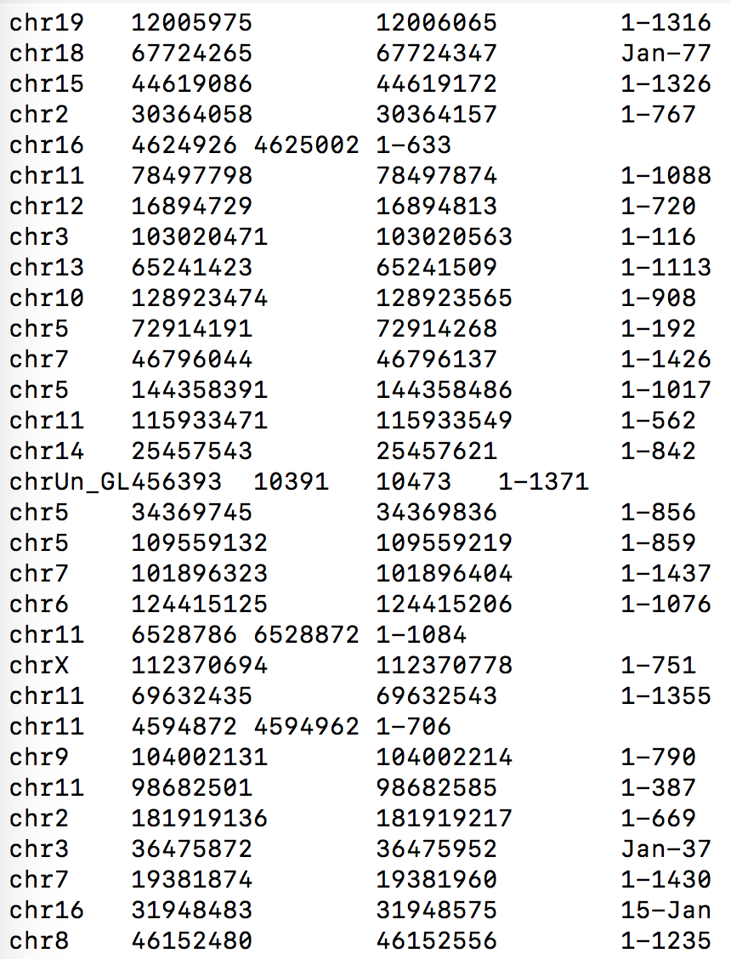

Slide 22
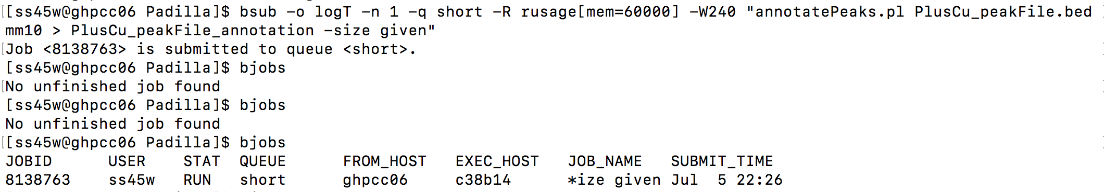

Slide 23
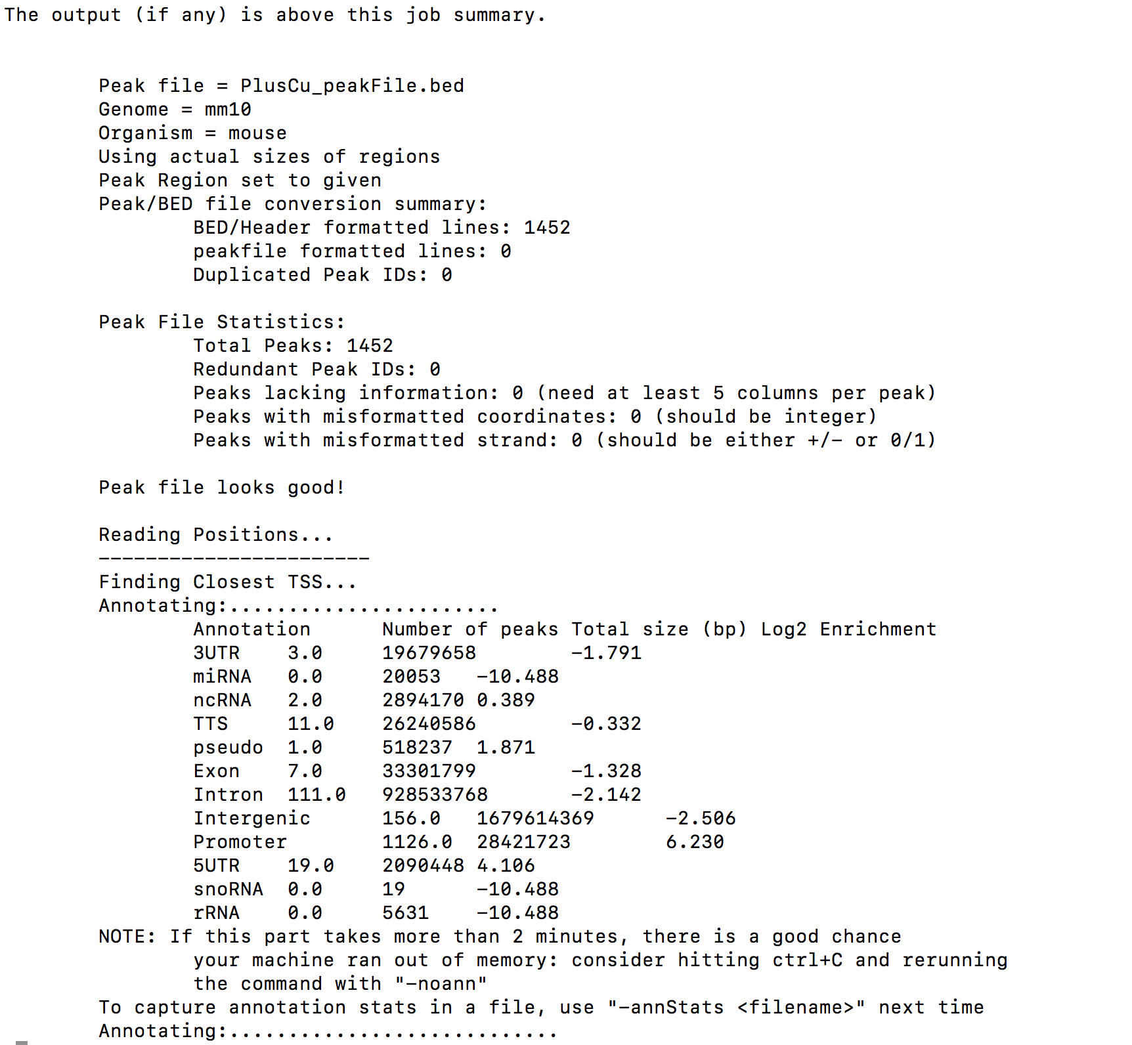

Slide 24
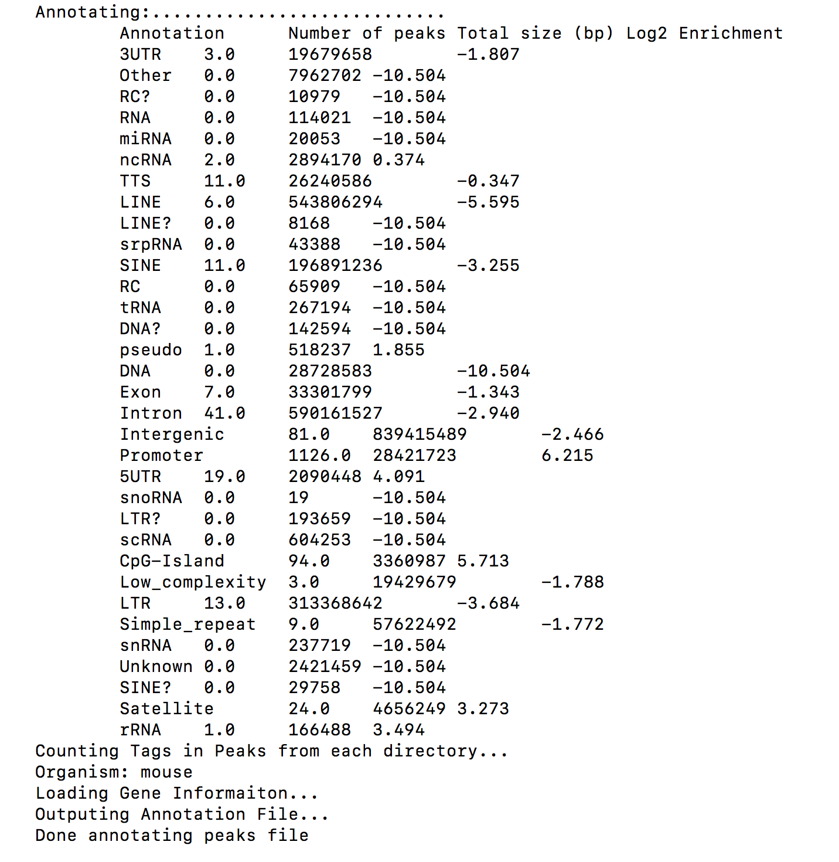

Slide 25
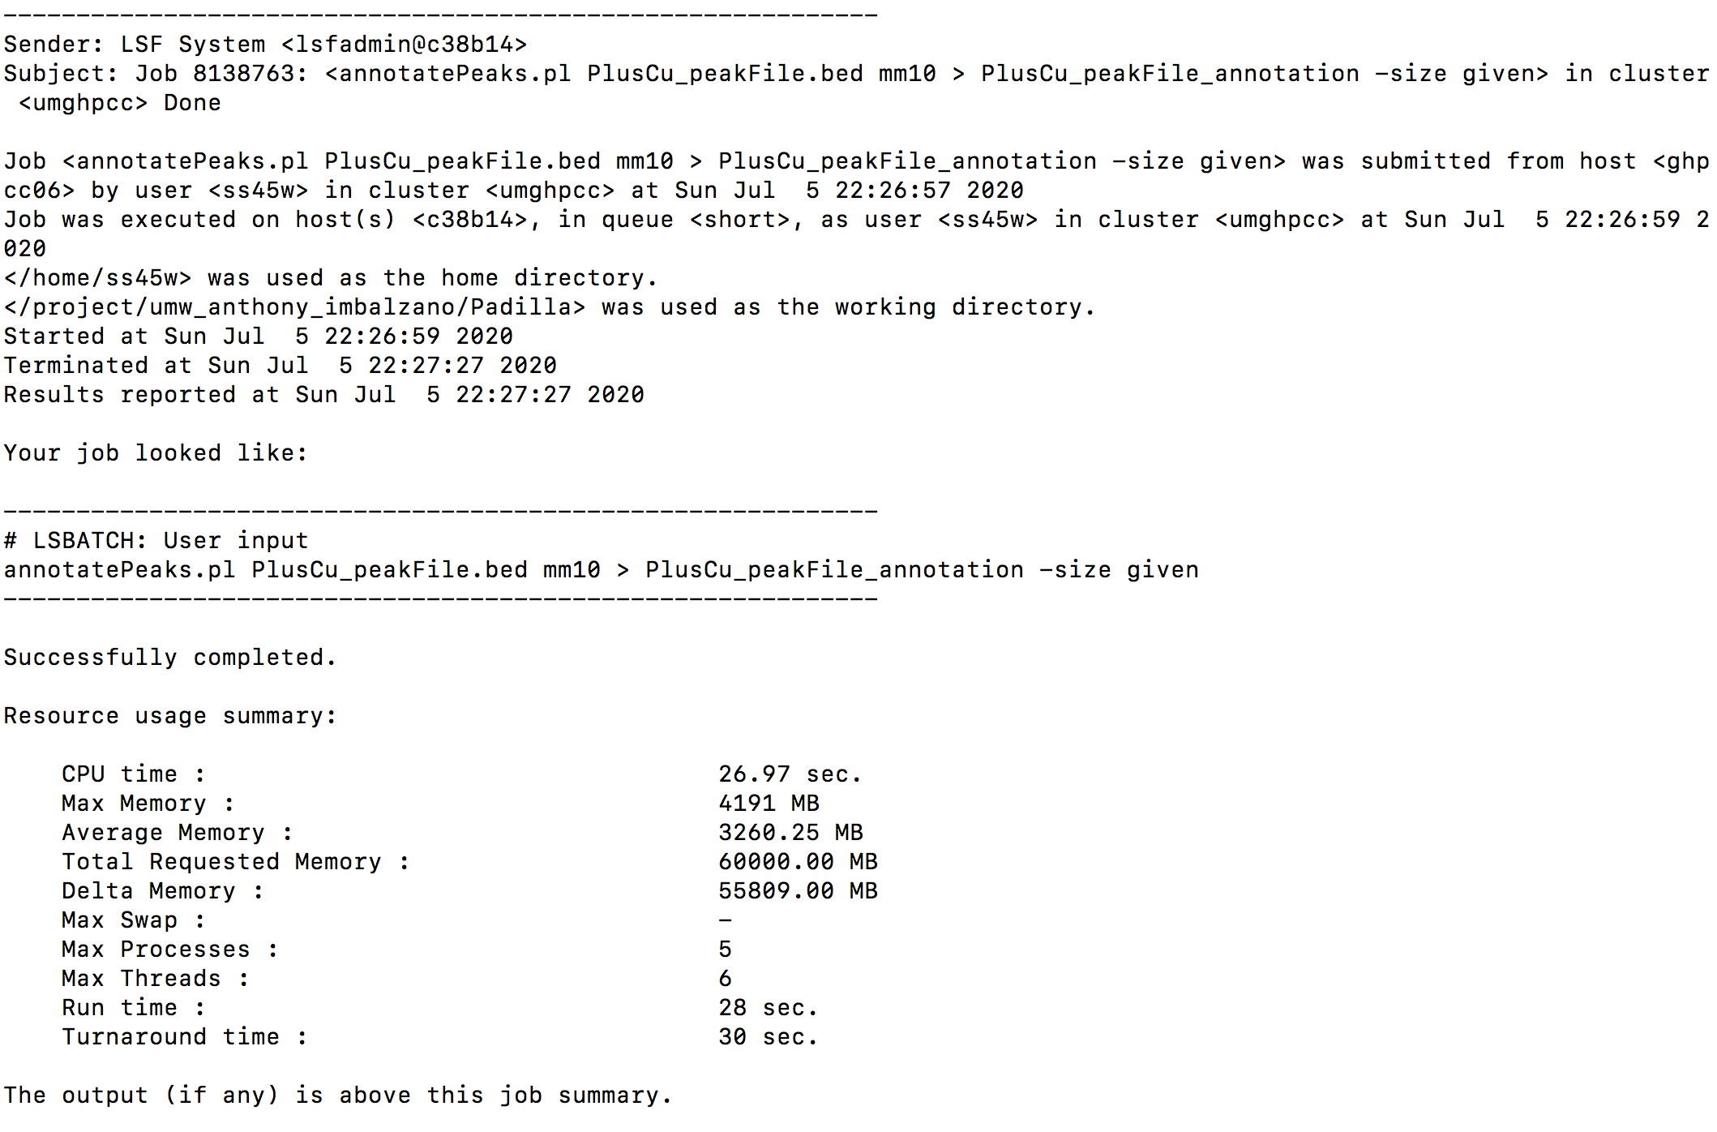

Slide 26
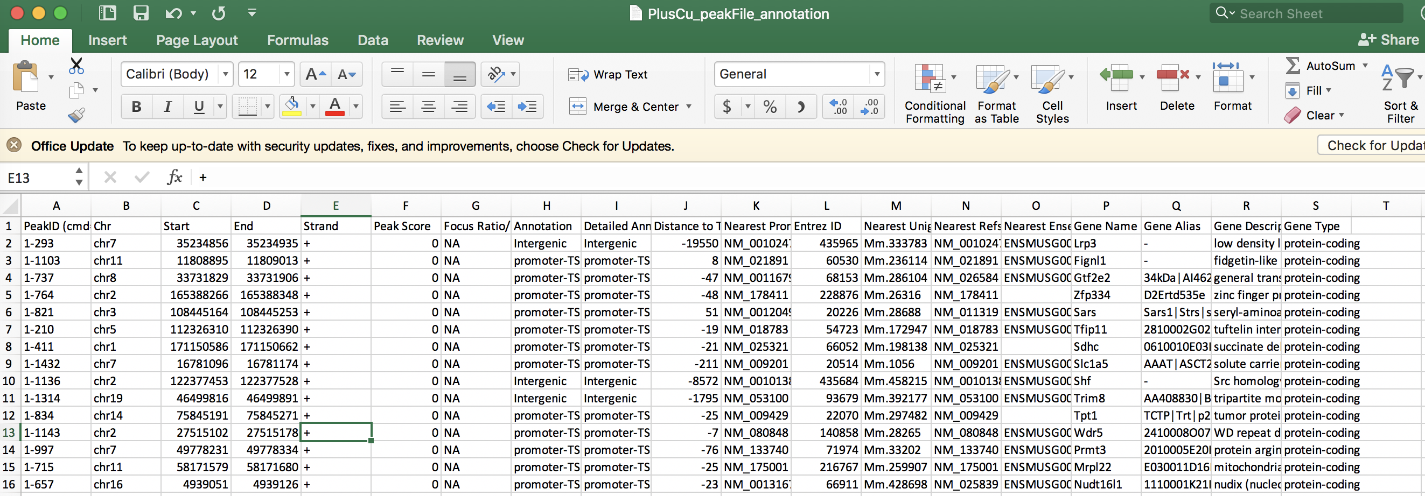

Slide 28
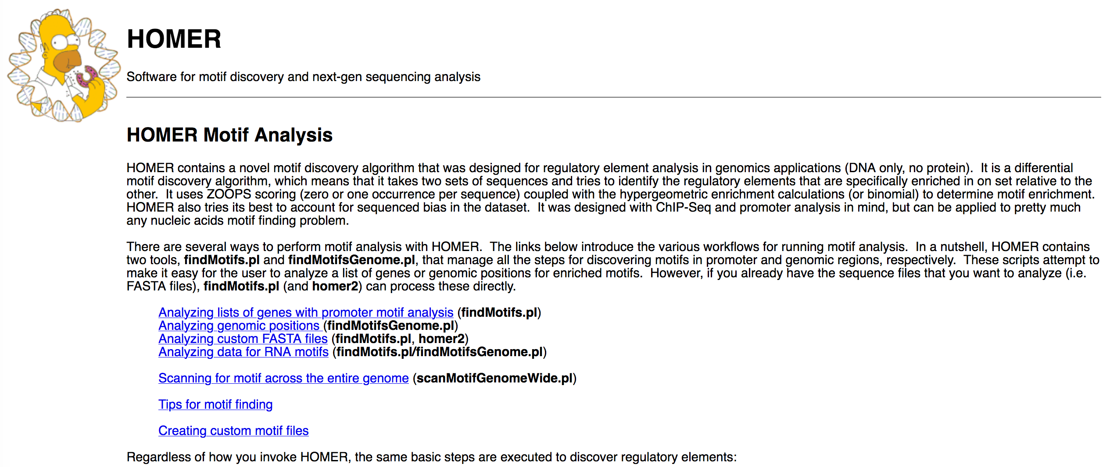
http://homer.ucsd.edu/homer/motif/

Slide 29
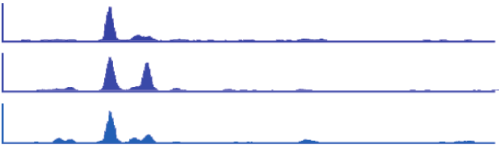
Binding profile
1 kb
Oct4
Nanog
Sox2
Oct4
(mouse Chr 17)
50 kb
H3K4me3
H3K36me3
FoxP1
(mouse Chr 3)
1 kb
RNAP II
ZFP36
(human Chr 19)
Kagey et al. (2010). Nature 467: 430
Mikkelsen et al. (2007). Nature 448: 553
Pepke et al. (2009). Nat. Methods 6: S22

Slide 30
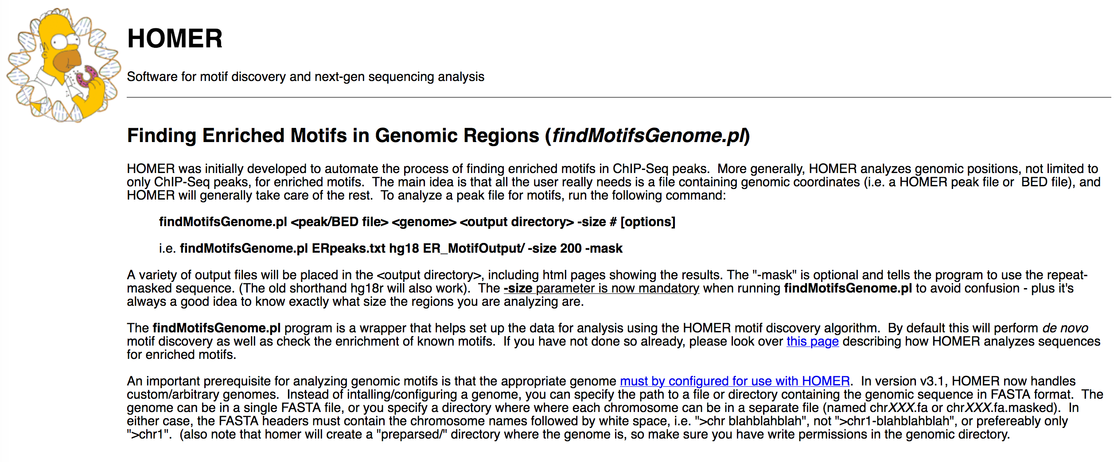
http://homer.ucsd.edu/homer/ngs/peakMotifs.html

Slide 31
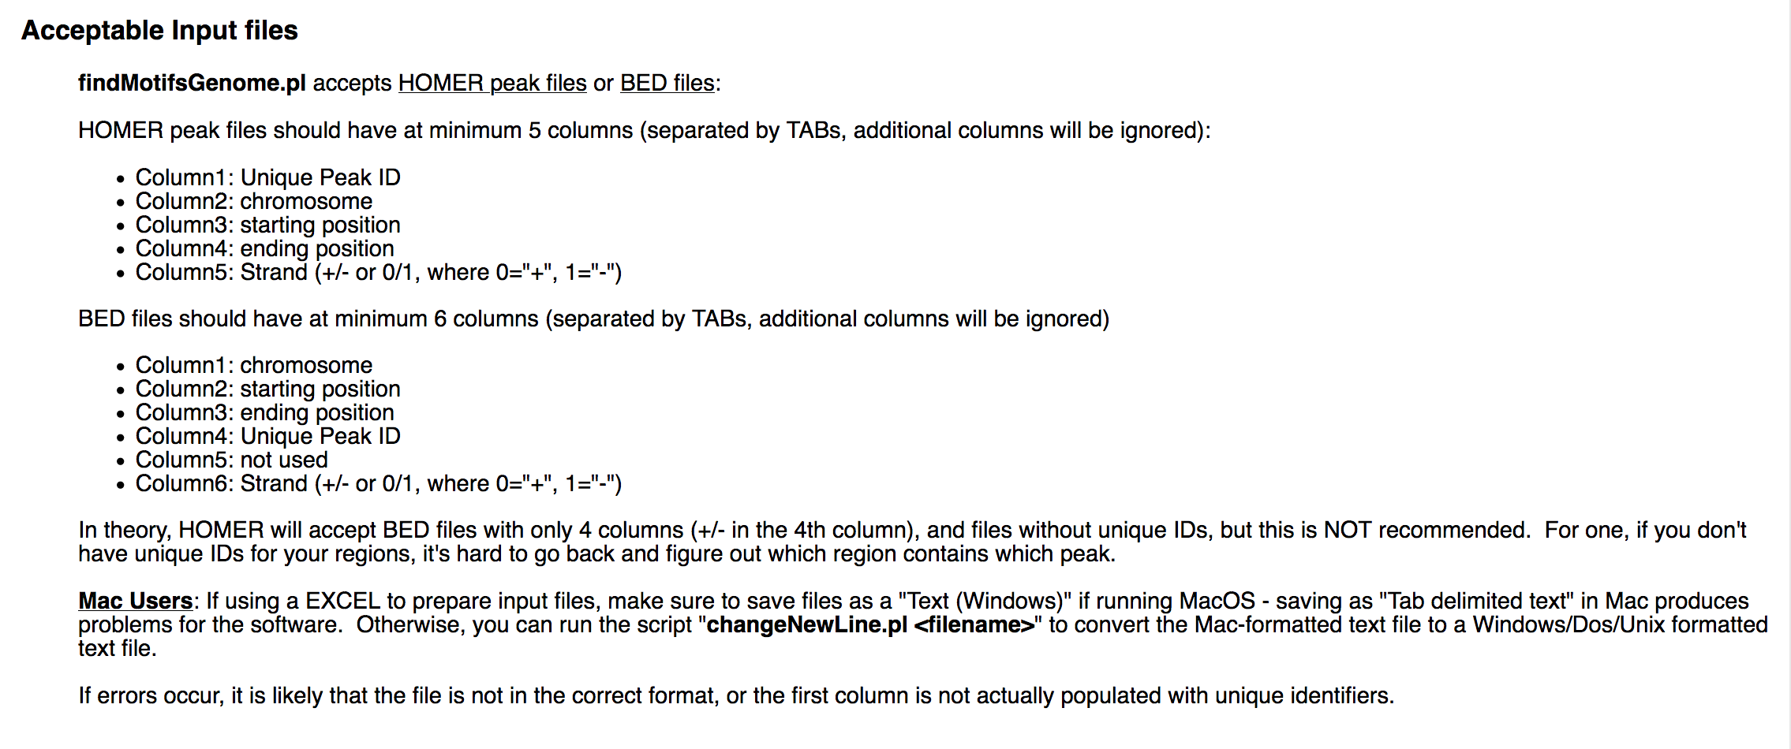
http://homer.ucsd.edu/homer/ngs/peakMotifs.html

Slide 32
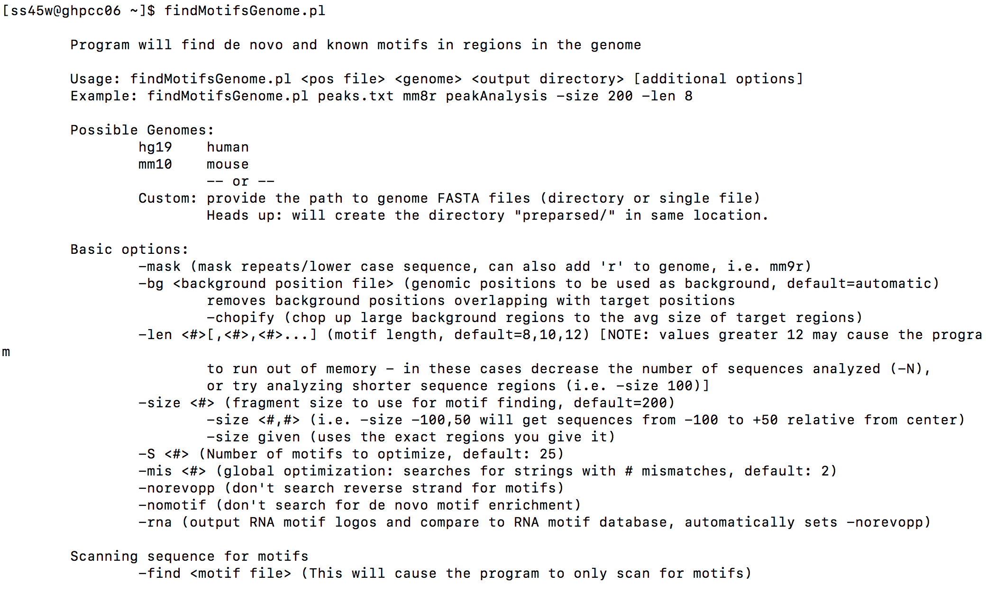

Slide 33
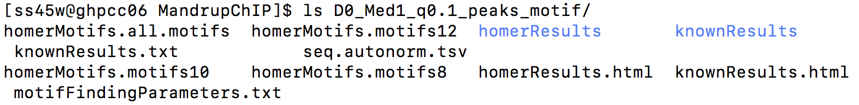
bsub -o logT -n 1 -q short -R rusage[mem=60000] -W240
"findMotifsGenome.pl -preparsedDir D0_Med1_q0.1_peaks.narrowPeak.bed mm10 D0_Med1_q0.1_peaks_motif -size given"
File location
/nl/umw_anthony_imbalzano/Sabriya/MandrupChIP/

Slide 34
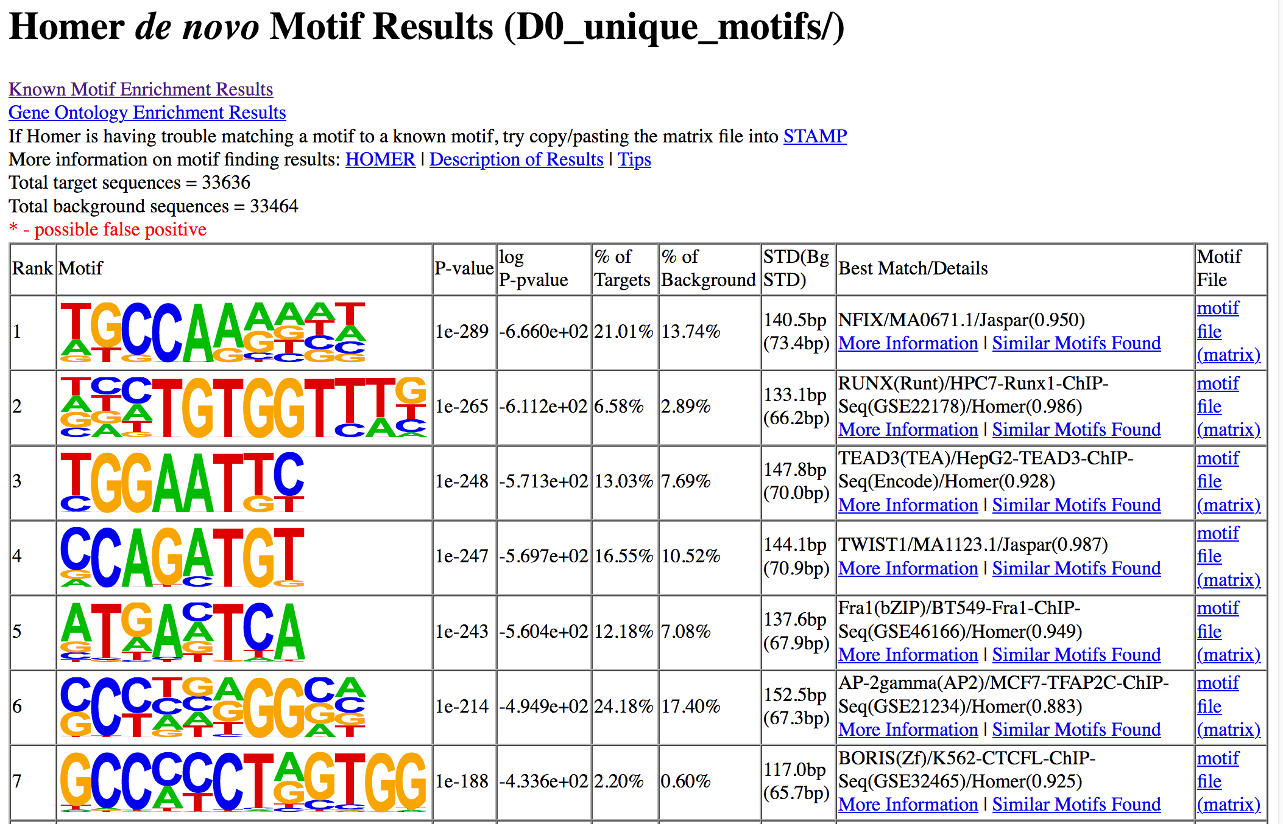

Slide 35
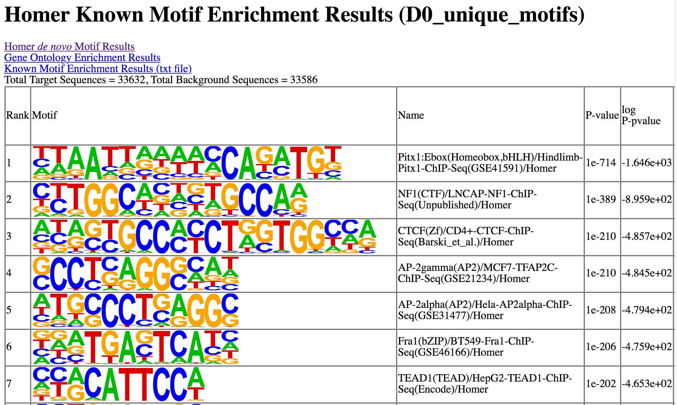

Slide 36
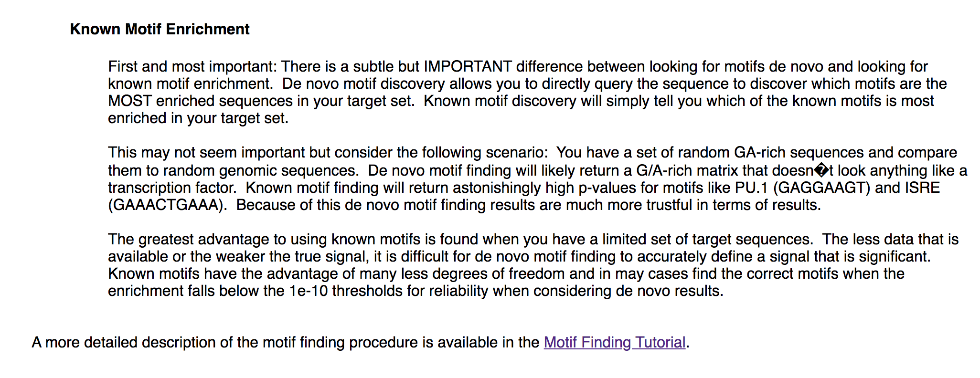
http://homer.ucsd.edu/homer/introduction/basics.html

Slide 38
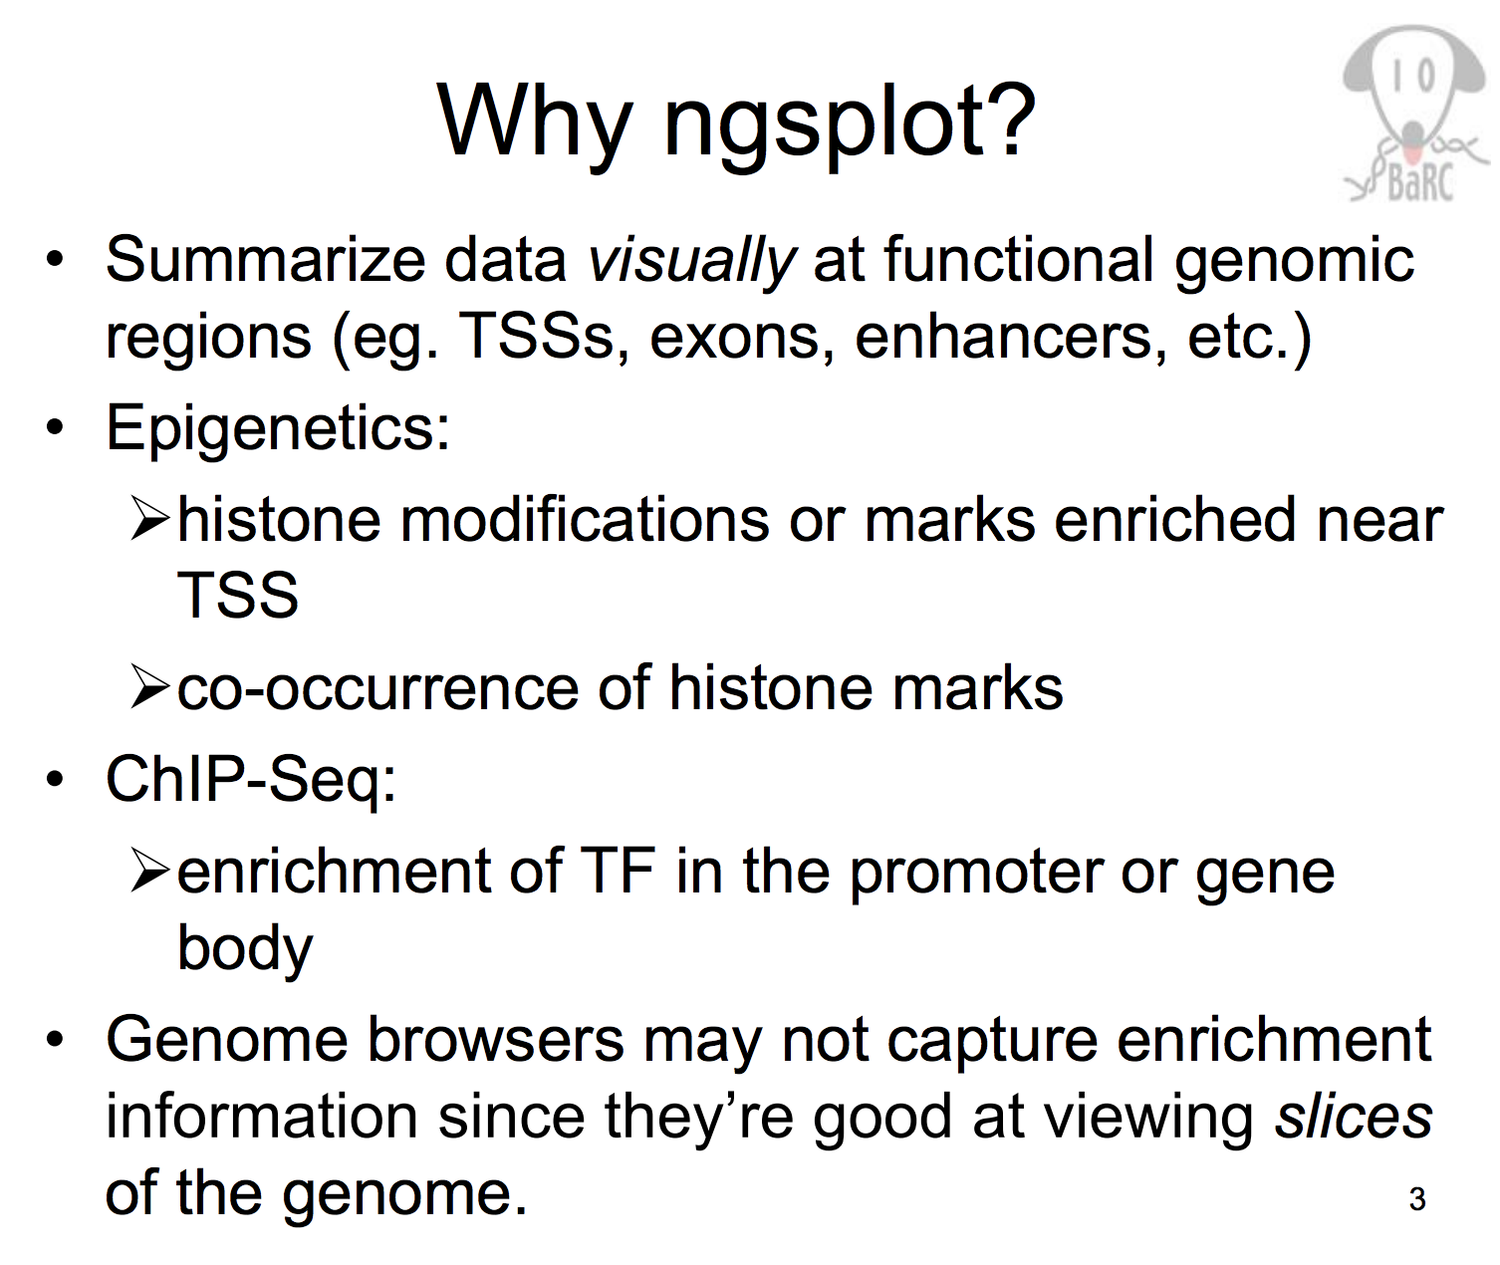
http://barc.wi.mit.edu/education/hot_topics/ngsplot/ngsplot_Apr2014.pdf

Slide 39
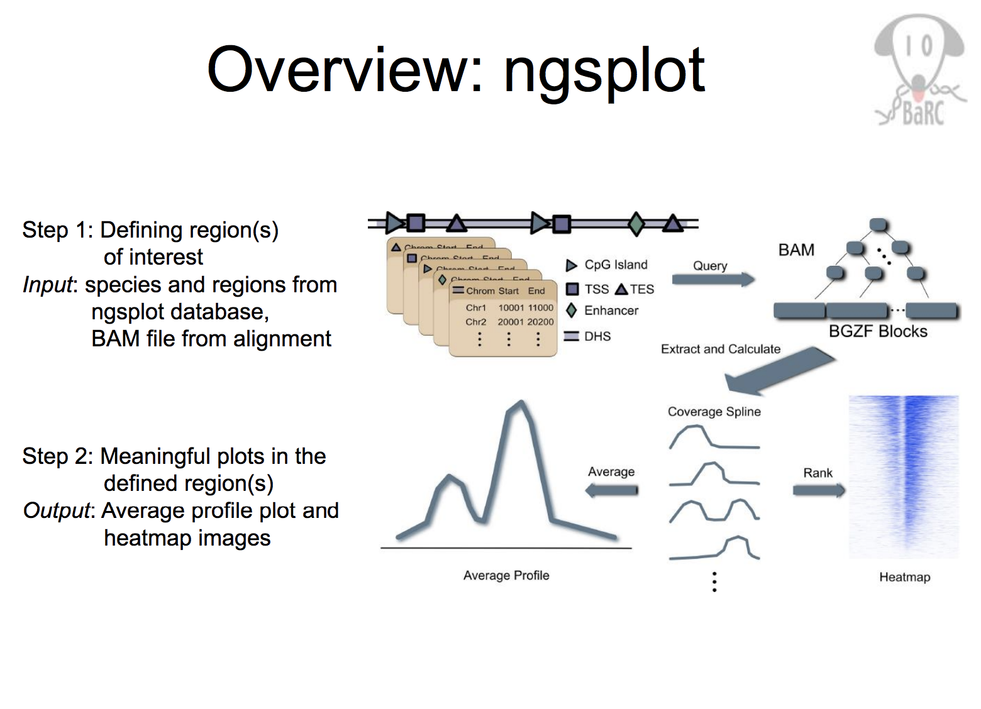
http://barc.wi.mit.edu/education/hot_topics/ngsplot/ngsplot_Apr2014.pdf

Slide 40
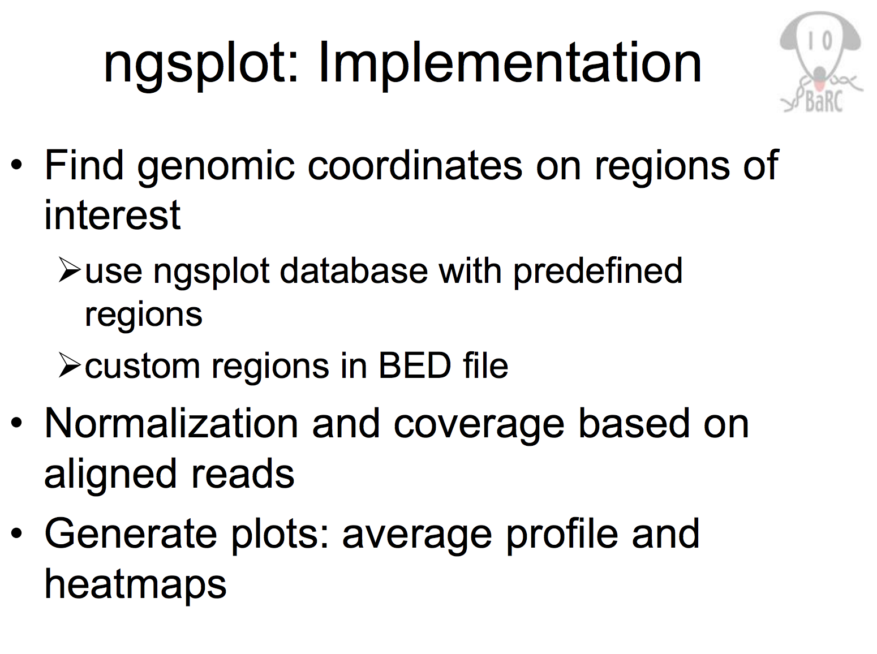

Slide 41
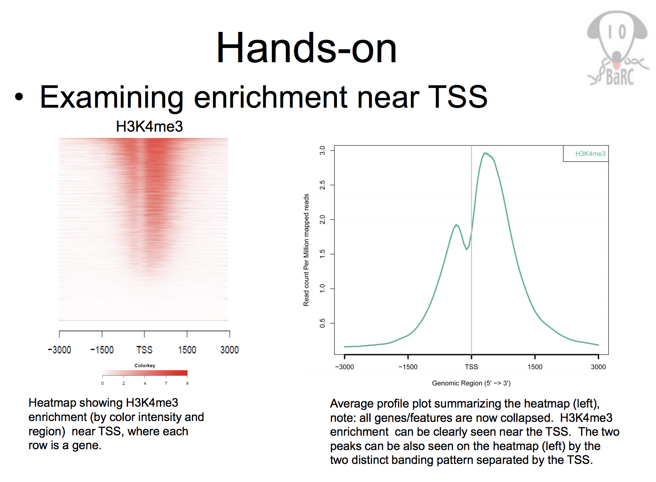

Slide 42
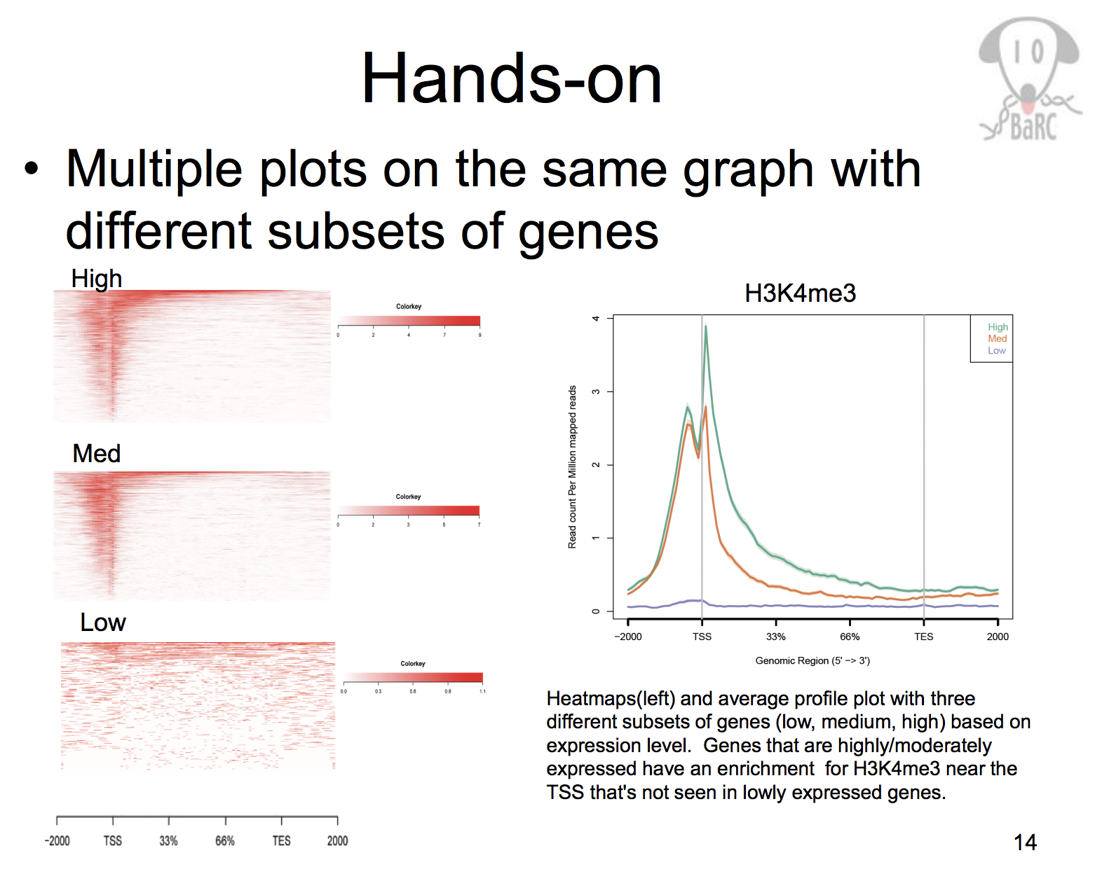

Slide 43
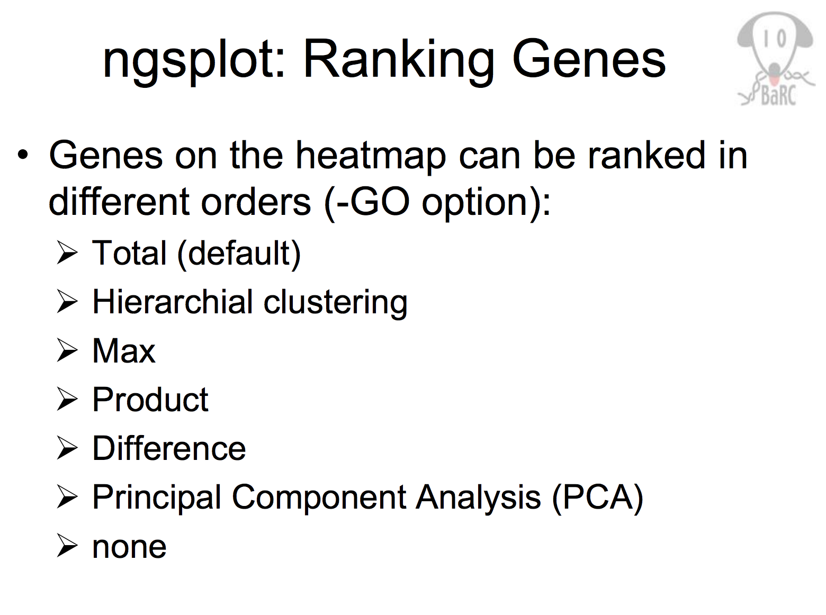
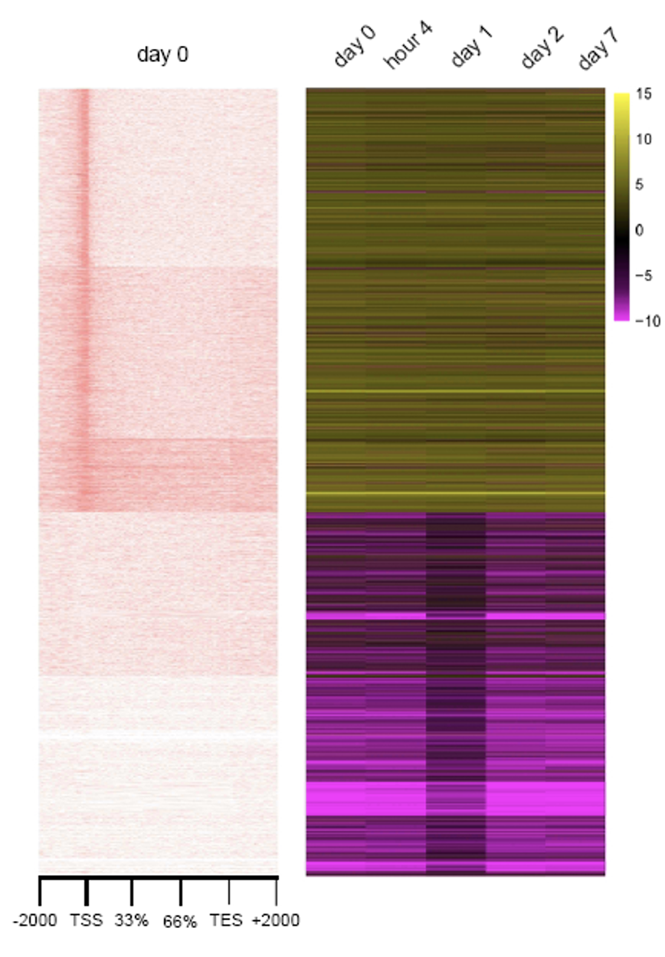

Slide 44
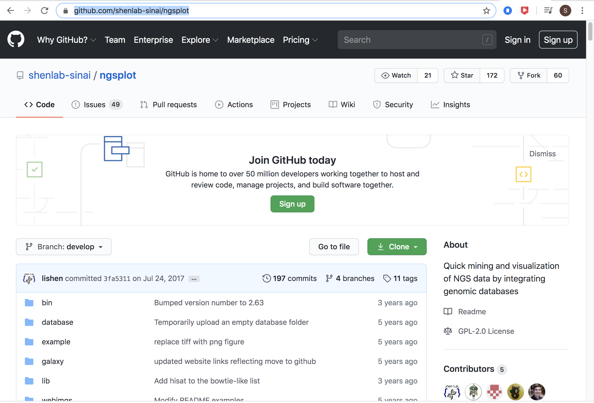
https://github.com/shenlab-sinai/ngsplot

Slide 45
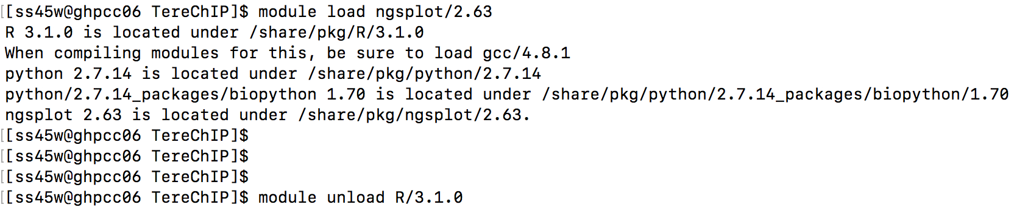
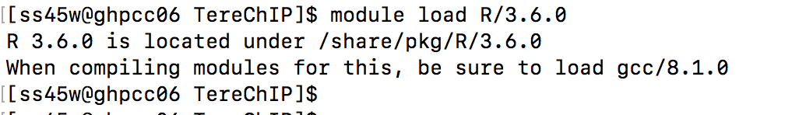
Running NGSplot on GHPCC06.umassrc.org

Slide 46
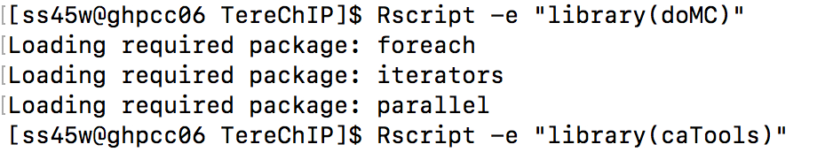
NGSplot requires several R packages

Slide 47
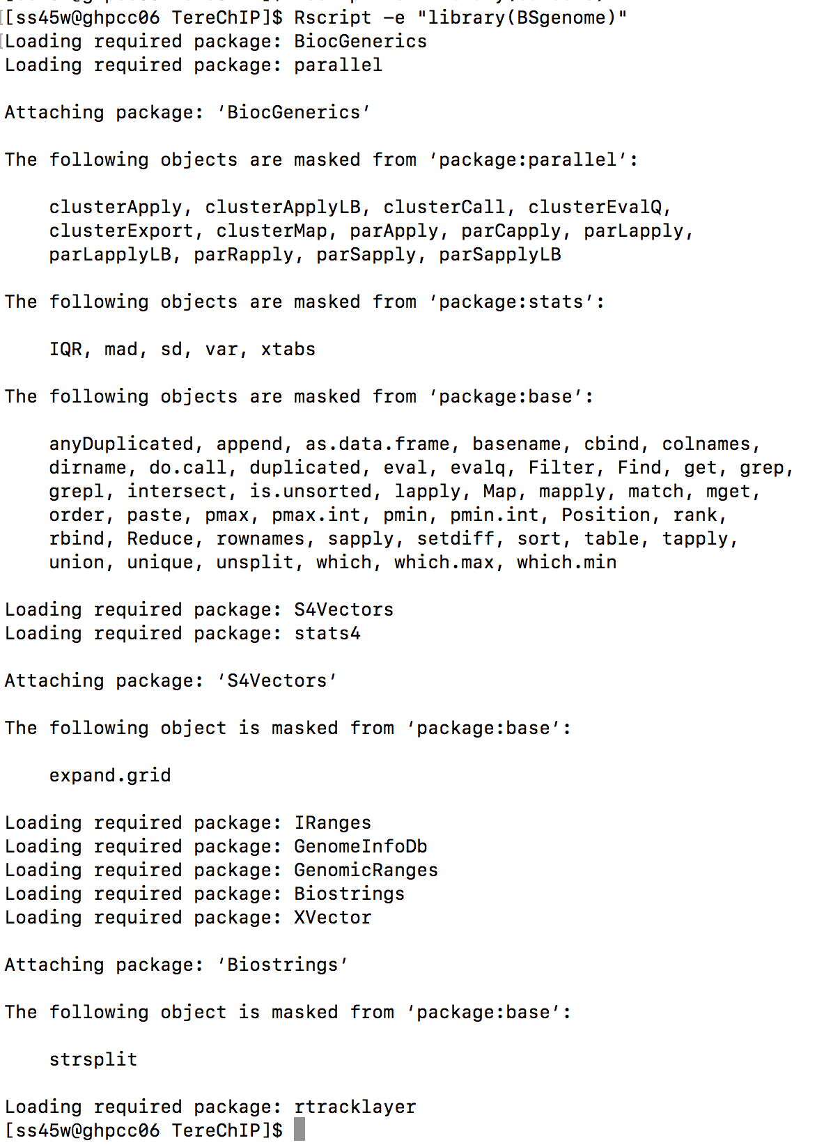
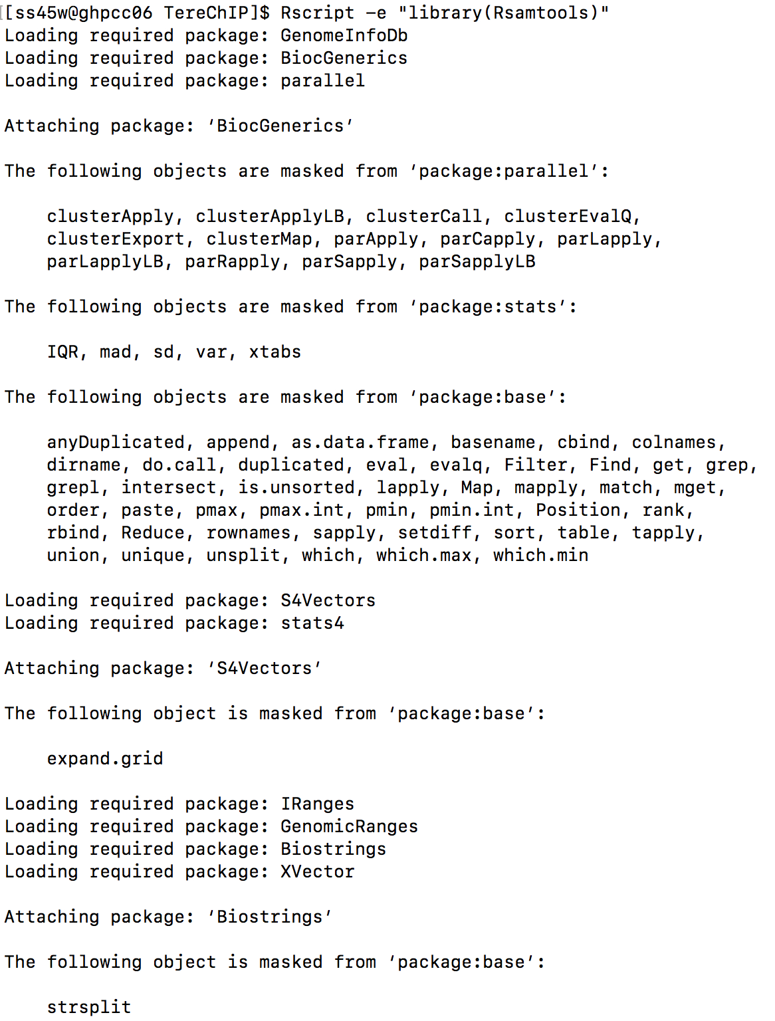

Slide 48
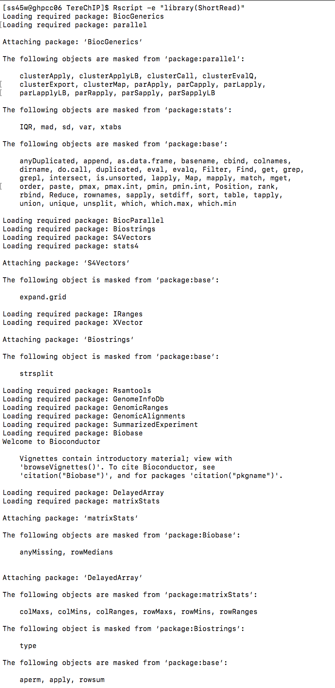

Slide 49
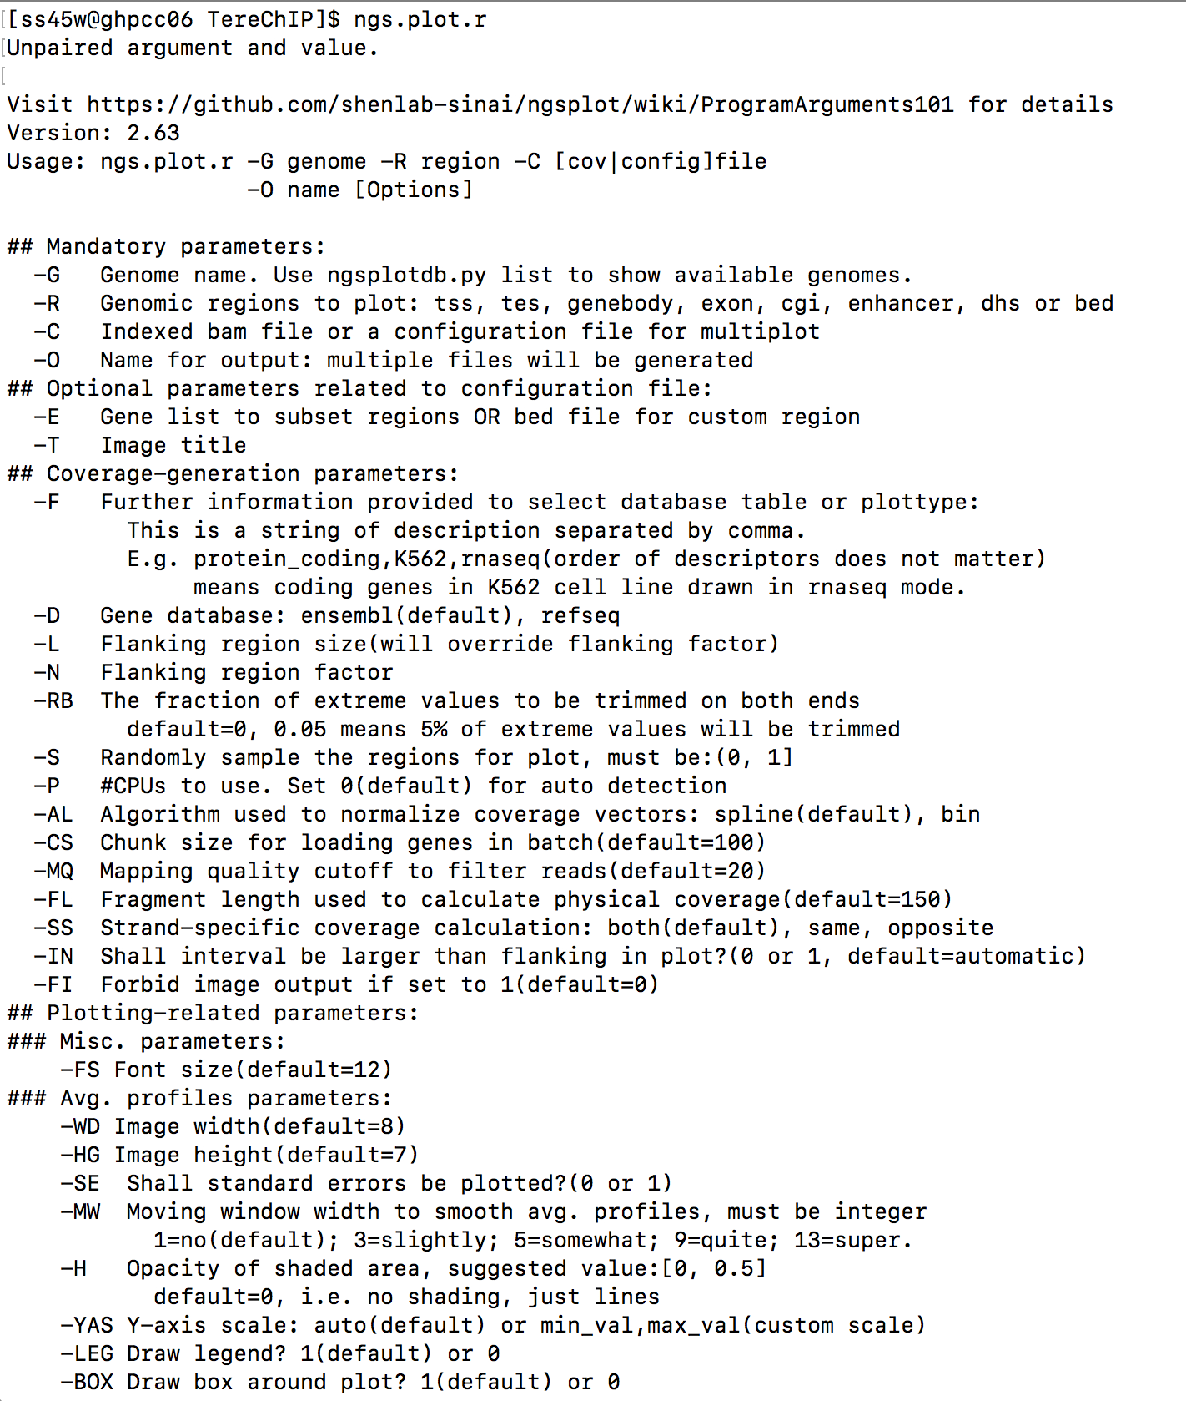
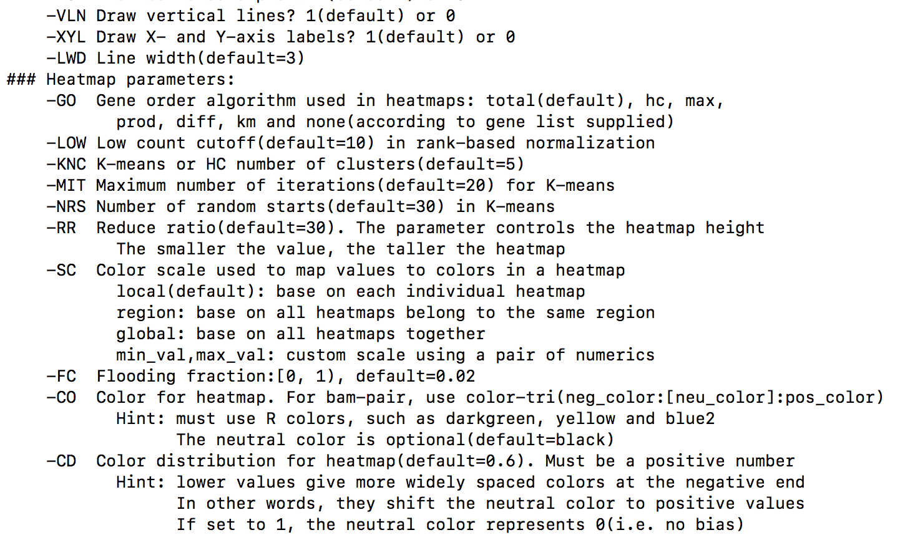

Slide 50

bsub -o logT -n 1 -q short -R rusage[mem=20000] -W240 "ngs.plot.r -G mm10 -R genebody -C D0_Med1_2_SRR5297599.sorted.bam -O D0_Med1_2_3T3L1_genebody.km -L 2000 -GO km"
ngs.plot.r -G mm10 -R tss -L 2000 -C /Volumes/syeds/Imbalzano_Lab/ChIP-Seq_PearsonCorrelation/MACS_D0_Prmt5merged/D0_Prmt5_n1n2merged.bam -O D0_Prmt5_TSS_2kb

Slide 51




NGSplot output example

Slide 52

NGSplot output example – tag density values (100 bins)
This information can be refined and used to generate Peak density heatmaps for specific lists of genes (e.g. Mtf1 targets sites!)

Slide 53

NGSplot kmeans clustering gene order

